Slide 1
Section 11.3 Computer Sub Systems
Notes:
In this section, we will revisit the subsystems that we have been discussing and show their physical implementation at the circuit level.

Slide 2
Computer Sub Systems
Computer has three major components:
Central Processing Unit (CPU)
instructions are fetched and executed
Memory system
Programs and data are stored
Input/Output (I/O) system
Handles input and output data to and from the memory system
Notes:
In review, a computer is basically composed of three major components:
Central Processing Unit (CPU) where
instructions are fetched and executed
Memory system where
Programs and data are stored
Input/Output (I/O) system which is
is responsible for input and output data to and from the memory system.

Slide 3
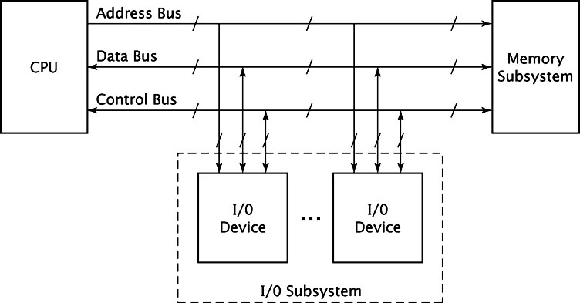
Computer Sub Systems
System structure shown in this diagram:
Notes:
And the System structure is shown in this familiar diagram.
However now we have learned that this is a block diagram and there are actually circuits contained in these boxes.
The text goes into detail on applying this to Registers, Buses, Memory subsystems, and address decoding.
Let’s look a few topics that the text does not discuss.

Slide 4
Clocks
Computer contains at least one clock
A fixed number of clock cycles are required to:
carry out each data movement
carry out each computational operation
Clock frequency
measured in megahertz or gigahertz
determines speed all operations are carried out
Clock cycle time
the reciprocal of clock frequency
An 800 MHz clock has a cycle time of 1.25 ns
Notes:
Every computer contains at least one clock that synchronizes the activities of its components.
A fixed number of clock cycles are required to carry out each data movement or computational operation.
The clock frequency, measured in megahertz or gigahertz, determines the speed with which all operations are carried out.
Clock cycle time is the reciprocal of clock frequency.
An 800 MHz clock has a cycle time of 1.25 ns.

Slide 5
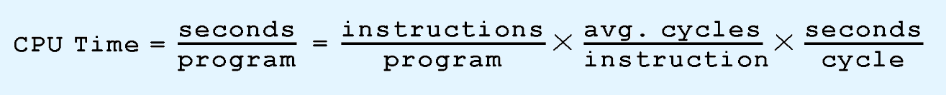
Clocks
Clock speed does not equate to CPU performance
CPU time required to run a program is given by this equation:
Improve CPU throughput
Reduce number of instructions in program
Reduce number of cycles per instruction
Reduce number of nanoseconds per clock cycle
Notes:
Clock speed should not be confused with CPU performance.
The CPU time required to run a program is given by the general performance equation:
We see that we can improve CPU throughput when we reduce the number of instructions in a program, reduce the number of cycles per instruction, or reduce the number of nanoseconds per clock cycle.

Slide 6
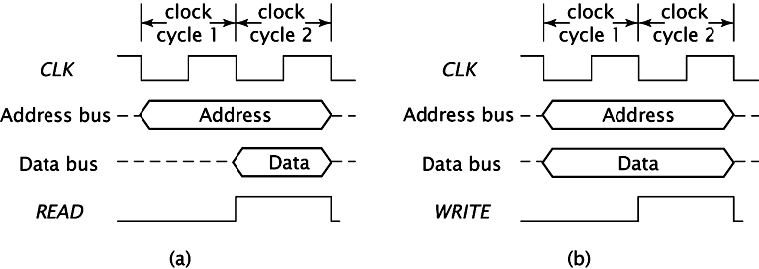
Timing and Other Operations
Components synchronized by the system clock
Clock "ticks" insure operations happen at regular intervals
For memory read operations (Fig (a) below):
CPU places address on the address bus
Memory subsystem accesses the desired memory location
CPU asserts READ signal
Memory places data onto the data bus
For memory write operations (Fig (b) below):
CPU places address and data on respective buses
Asserts WRITE signal
Memory writes data at the given address
For operations (on computers with isolated I/O):
CPU must assert IO/M signal
Set to 1 means I/O operations, set to 0 means memory operation
Notes:
All components synchronized by the system clock which issues regular clock "ticks" that insure operations happen at regular intervals.
For memory read operations (Fig (a) below):
CPU places address on the address bus
Memory subsystem accesses the desired memory location
CPU asserts READ signal
Memory places data onto the data bus
For memory write operations (Fig (b) below):
CPU places address and data on respective buses
Asserts WRITE signal
Memory writes data at the given address
For operations (on computers with isolated I/O):
CPU must assert IO/M signal
Set to 1 means I/O operations, set to 0 means memory operation

Slide 7
Memory System
Memory system - an array of memory locations
Each stores multiple-bit binary data (typically 8 bits called a byte)
Memory locations are selected by address for either read or write operation
It normally has
address input for the address to select the location
data input for the data to the written to the location
data output for the data read from the location
chip enable control to enable the entire memory
read/write control to start read or write operation
Notes:
A memory system can be viewed as an array of memory locations each of which can store a multiple-bit binary data (typically 8 bits called a byte).
Memory locations are selected by address for either read or write operation.
It normally has
address input for the address to select the location
data input for the data to the written to the location
data output for the data read from the location
chip enable control to enable the entire memory
read/write control to start read or write operation

Slide 8
Memory Organization
Computer memory
Linear array of addressable storage cells similar to registers
Byte-addressable, or word-addressable,
word typically consists of two or more bytes
Constructed of RAM chips, often referred to in terms of length × width.
If memory word size is 16 bits
A 4M × 16 RAM chip has 4 megabytes of 16-bit memory locations
Notes:
Computer memory consists of a linear array of addressable storage cells that are similar to registers.
Memory can be byte-addressable, or word-addressable, where a word typically consists of two or more bytes.
Memory is constructed of RAM chips, often referred to in terms of length × width.
If the memory word size of the machine is 16 bits, then a 4M × 16 RAM chip gives us 4 megabytes of 16-bit memory locations.

Slide 9
Memory Organization
Memory Types
Read-Only Memory (ROM)
Masked ROM is manufactured with data inside; does not change
Programmable ROM (PROM)
program-once devices
Erasable PROM (EPROM)
erased by holding the chip's "window" under ultraviolet light
Electrically erasable PROM (EEPROM)
erased by the programming device; portions can be selectively erased
Flash EEPROM
erasable in blocks (good for digital cameras).
All ROM chips have:
n address pins (An-1...A0) selecting 2n locations,
m data pins (Dm-1 ...D0).
CE chip enable that enables/disables the entire chip
OE output enable that keeps the ROM from outputting data

Slide 10
Memory Organization
Memory Types (cont)
Random Access Memory (RAM)
Dynamic RAM (DRAM)
constructed from leaky capacitors and requires periodic recharge.
Static RAM (SRAM)
does not need refreshing; more expensive
All RAM chips have:
n address pins (An-1... A0) selecting 2n locations
m data pins (Dm-1 ...D0
some kind of R/W input that indicates if RAM should read or write data

Slide 11
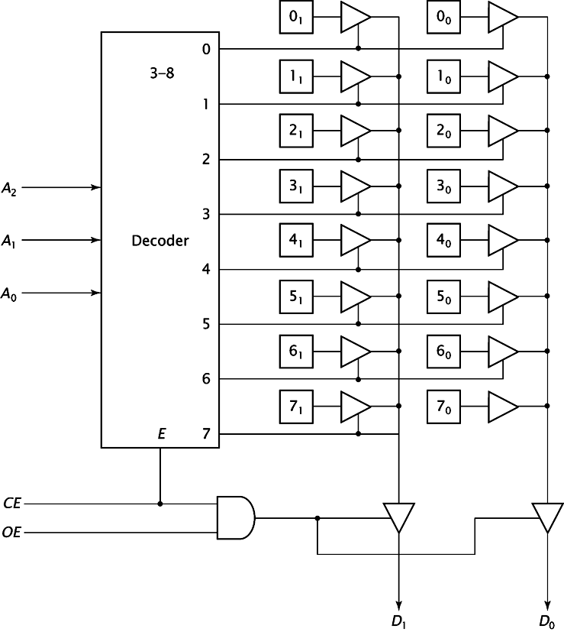
Chip Organization
Simple 8x2 ROM configuration using linear organization, like fig 11.41
Notes:
Here's a a simple 8x2 ROM configuration using linear organization, like fig 11.41

Slide 12
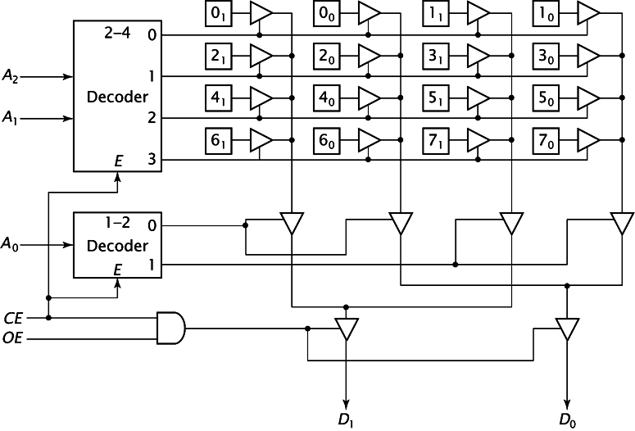
Chip Organization
When number of memory locations becomes large
more than one decoder needed because the size of the decoder becomes too large
Below a 8 x 2 ROM using a 2d organization

Slide 13
Memory Subsystem
The storage for each bit in the memory can be
a D-latch for static memory (fast and expensive)
or other devices for dynamic memory

Slide 14
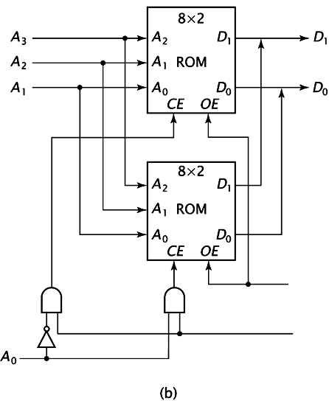
Memory Subsystem
How to build a memory system out of more than one chip?
Below a 16 x 2 ROM out of two 8 x 2 ROM's
Upper chip stores locations XXX0 and the lower chip stores locations XXX1.
Low-order interleaving can provide multi-byte read capabilities.

Slide 15
Memory Subsystem
Physical memory usually consists of more than one RAM chip
Access is more efficient when memory is organized into banks of chips with the addresses interleaved across the chips

Slide 16
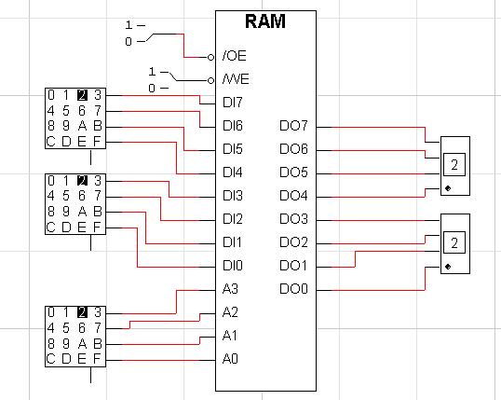
Memory Subsystem
A 16x8 memory chip
/CE is active-low chip enable
/WE is read/write control
It is storing the value 22 at memory address 2

Slide 17
Multi-byte Organization
Byte ordering, or endianness
Another major architectural consideration
A two-byte integer
may be stored so that the least significant byte is followed by the most significant byte
or vice versa.
In Little endian machines
least significant byte is followed by the most significant byte
Big endian machines
most significant byte first (at the lower address)
Notes:
Byte ordering, or endianness is another major architectural consideration
If we have a two-byte integer, the integer may be stored so that the least significant byte is followed by the most significant byte or vice versa.
In Little endian machines, the least significant byte is followed by the most significant byte.
Big endian machines store the most significant byte first (at the lower address).

Slide 18
Multi-byte Organization
Big endian: most significant byte in location X, next byte in location X+1.
Little endian: least significant byte in location X, next byte in location X+1.
Alignment: storing bytes so they can be read in a multi-byte read.
E.g., Motorola 68040 can read 4 bytes, but only if the 2 least significant address bits are 00. Can read addresses 100, 101, 102, and 103 in one instruction cycle. However, it cannot read 101, 102, 103, and 104.

Slide 19
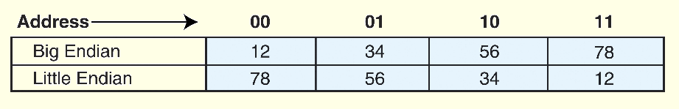
Multi-byte Organization
Example: hexadecimal number 12345678
big endian and small endian arrangements of the bytes are shown below

